Slide 1







Life of a program
Yazid HANIFI
Master 2 RFIA
Developer

Slide 2



1
Don’t just code!
There is more to programming than just code!

Slide 3









Don’t just code!
1
There is more to programming than just code!
Code is probably the easiest part
You will mess everything up
This is a way to bread bugs!
You will waste time

Slide 4
2
Understand the problem
فهم السّؤال نصف الجواب

Slide 5

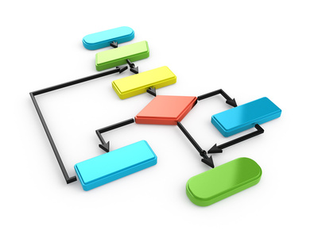
Understand the problem
2
فهم السّؤال نصف الجواب
Good conception comes from good understanding
Solve your own real problem
List the full functionalities and use cases

Slide 6
3
Conceptualize
You are an architect

Slide 7


Conceptualize
3
You are an architect
Fonctionalities technicalities
Algorithms
Database
Modules

Slide 8
4
Atomicity
Split the atom

Slide 9
Atomicity
4
Split the atom
One function does one job
Don’t take the fun out of the function! Make it short
A module doesn’t care about others
Classes should sign contracts

Slide 10
5
Be a seer
See the future

Slide 11

Be a seer
5
See the future
What kind of fonctionalities could I add?
Let the present you help the future you

Slide 12
6
Use a method
Because you need one

Slide 13
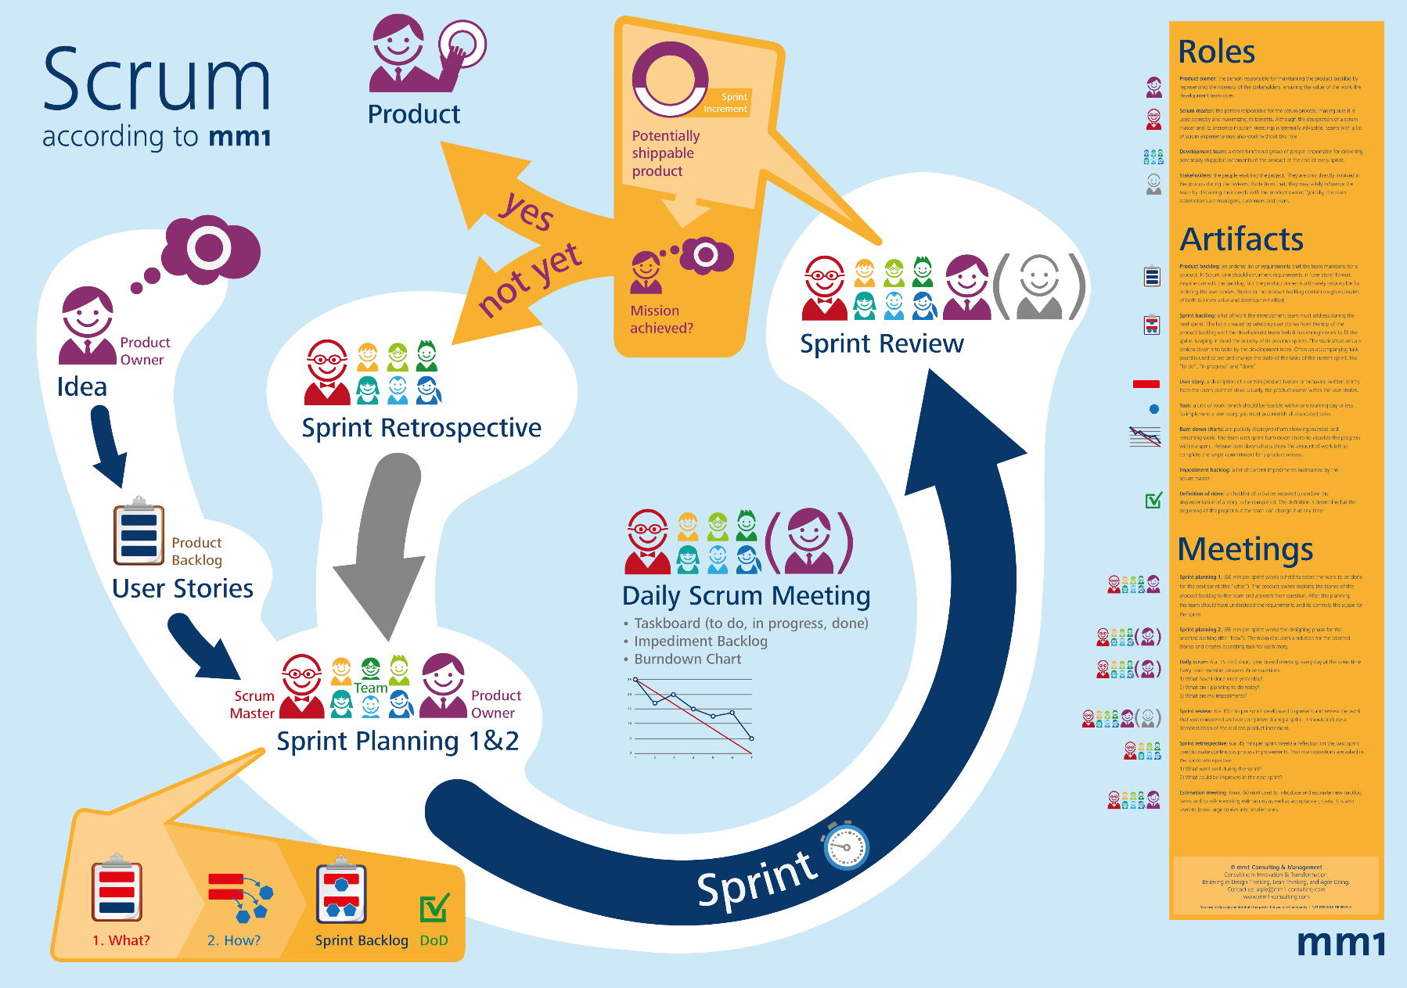
Use a method
6
Because you need one

Slide 14
7
The programming tools
You’re an engineer

Slide 15

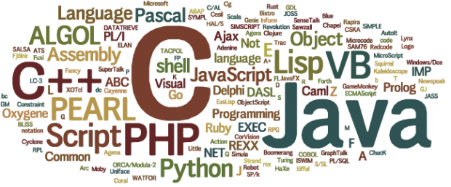
The programming tools
7
Your an engineer
What programming language?
What do you want?
What do you know?
How easy is it?
What do you like?
Community and documentation
What framework? Library?
What IDE?

Slide 16
8
Now we code
At last

Slide 17

Now we code
8
At last
It will be easier
You are only translating

Slide 18
9
Versioning
Remember the past

Slide 19

Versioning
9
Remember the past
Git your code
Github? Gitlab? Bitbucket?
This is a must

Slide 20
10
Codography
You’re an artist

Slide 21
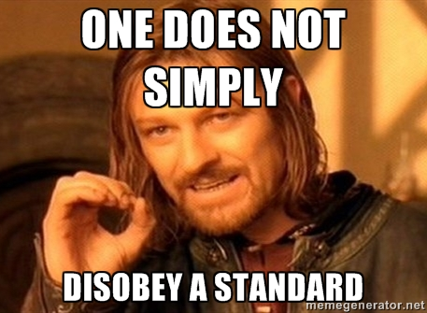
Codography
10
You’re an artist
Write beautiful code
Use a standard coding style
Comment but not too much

Slide 22
11
Testing
For resting

Slide 23
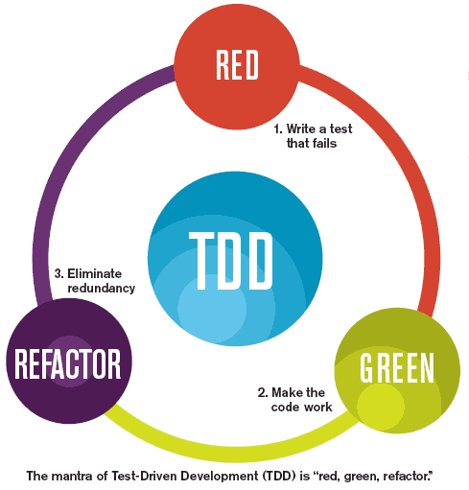
Testing
11
For resting
Test Driven Development
With more comes less
Easy to debug
Easy to extend

Slide 24
Code in peace

